Slide 1
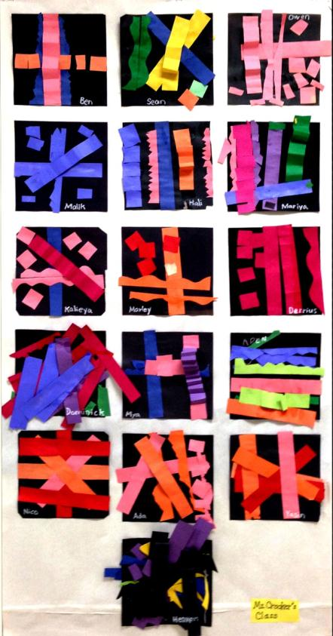
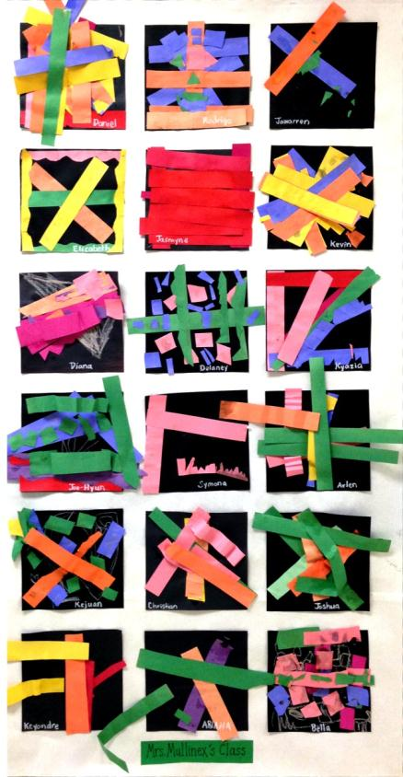
Albemarle County Public Schools
Agnor-Hurt Elementary School
Additions and Renovations
School Board Presentation
November 14, 2013

Slide 2
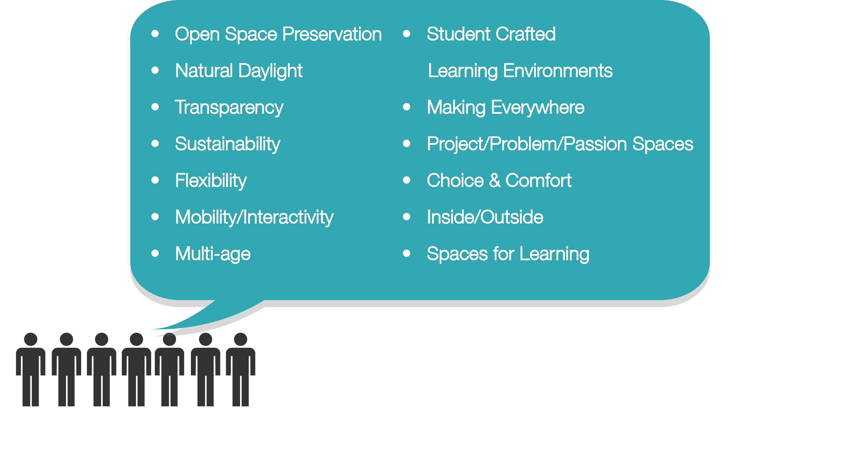
design imperatives

Slide 3
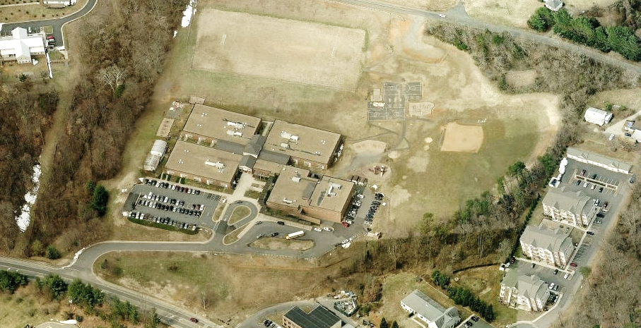

Woodburn Dr
cars
buses
Berkmar Dr
existing site

Slide 4
Woodburn Dr
buses
green space / outdoor play
P
14 buses
72 staff
P
P
20 staff
cars
36 staff / visitors
P
Berkmar Dr
site plan

Slide 5
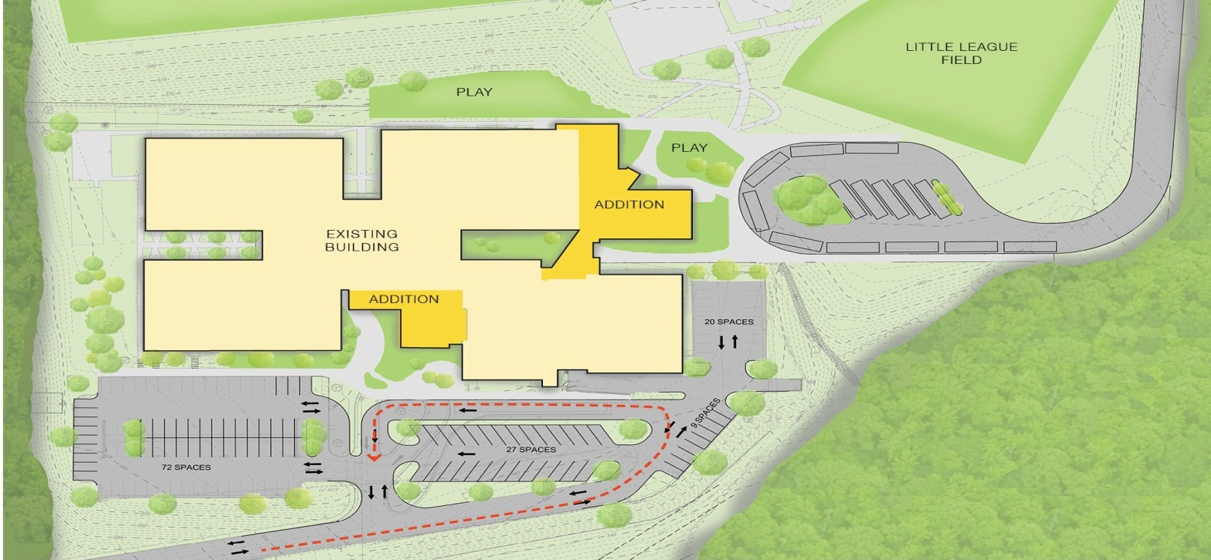
P
14 buses
P
20 staff
P
36 staff/visitors
72 staff
P
site plan

Slide 6
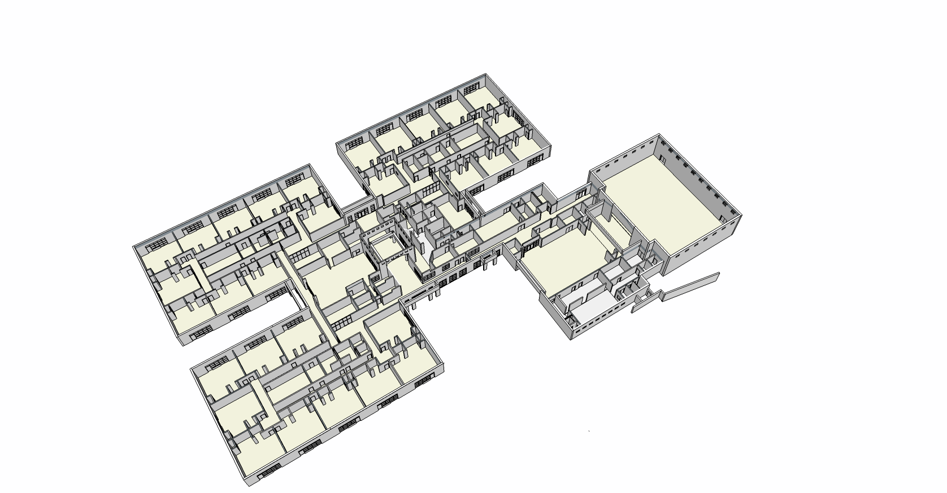
gym
dining
entrance
existing building

Slide 7
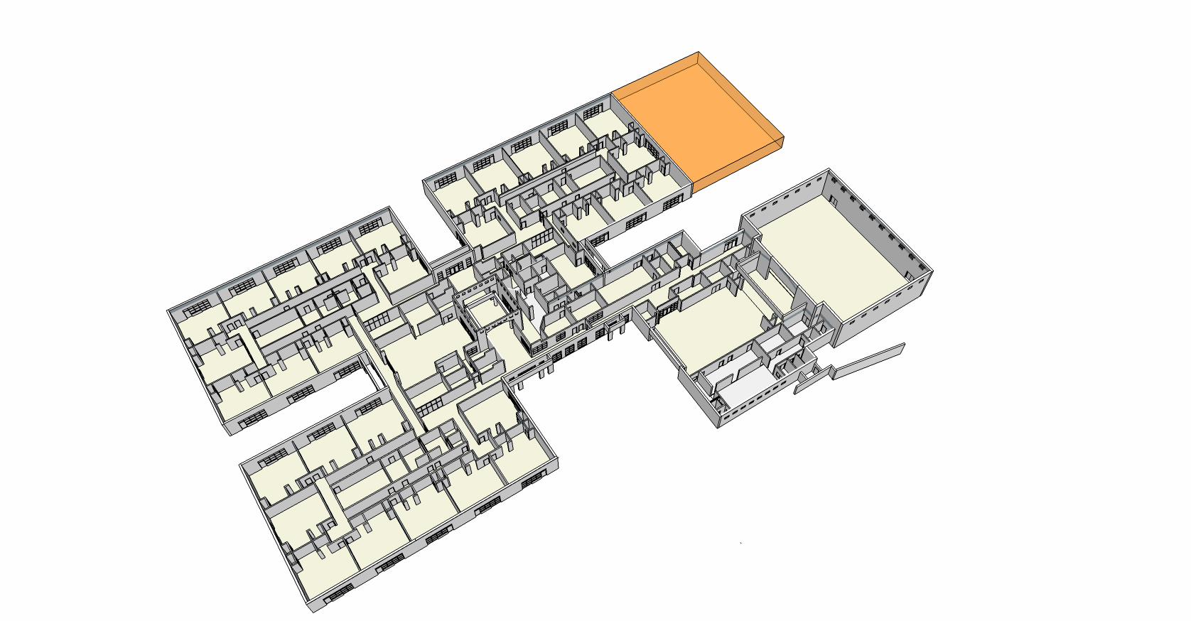
core classrooms
gym
dining
entrance
building strategy

Slide 8
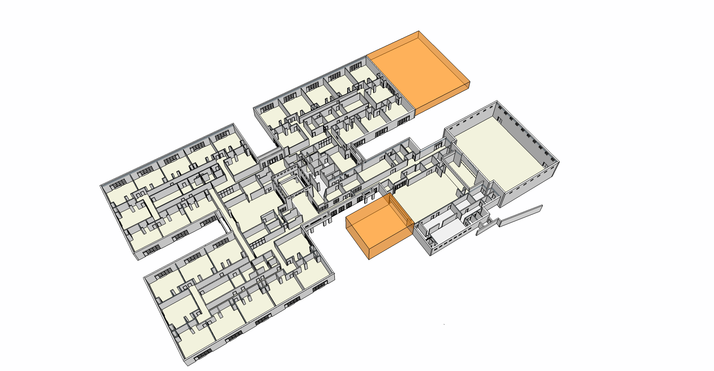
core classrooms
gym
dining
art pavilion
entrance
building strategy

Slide 9
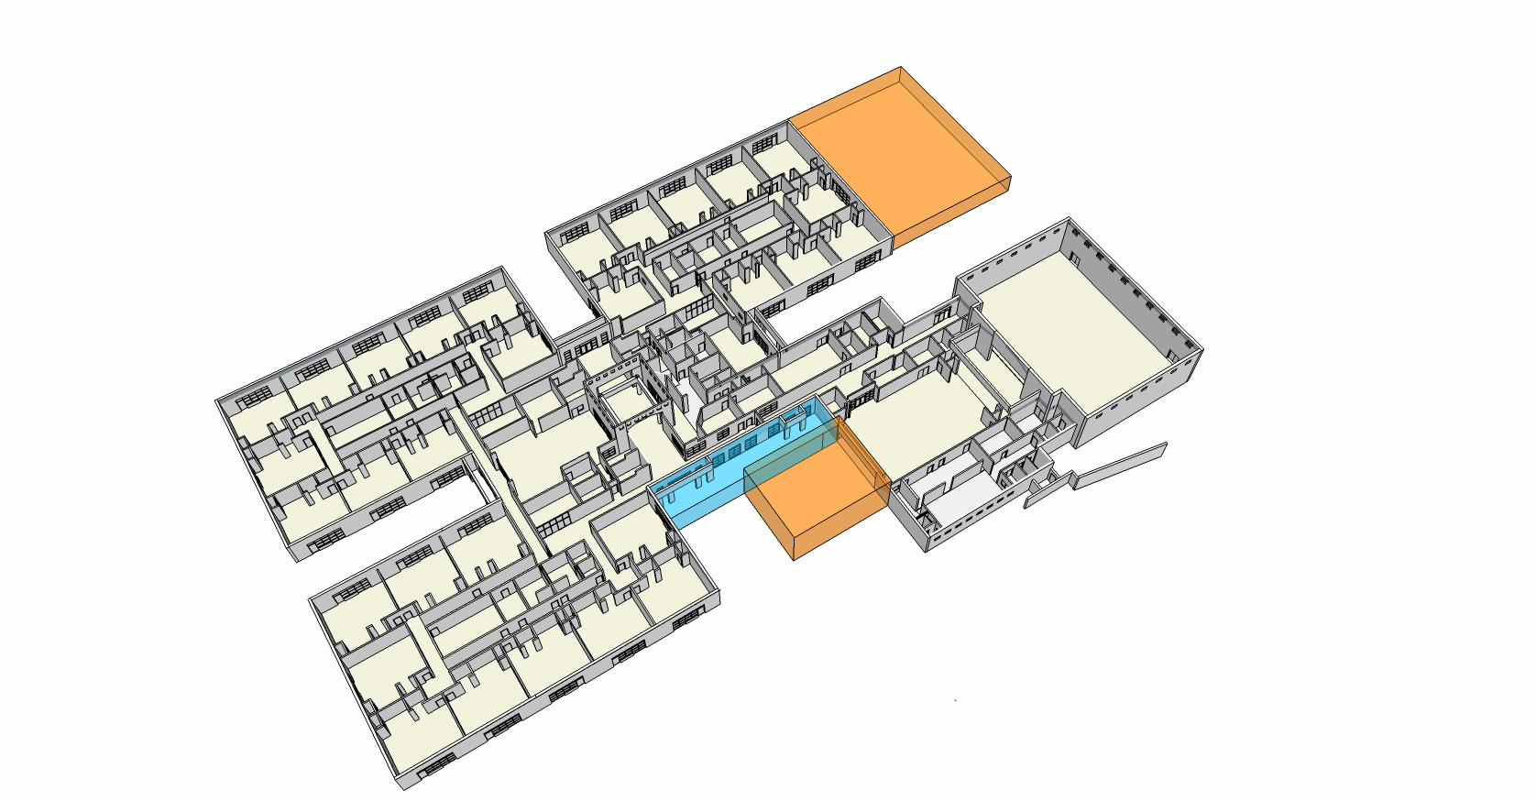
music
international portal
core classrooms
media center
enlarged rooms
gym
dining
art pavilion
entrance
building strategy

Slide 10
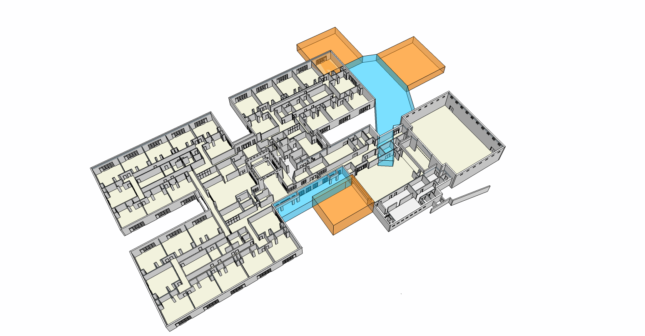
music
international portal
core classrooms
media center
enlarged rooms
gym
dining
art pavilion
entrance
building strategy

Slide 11
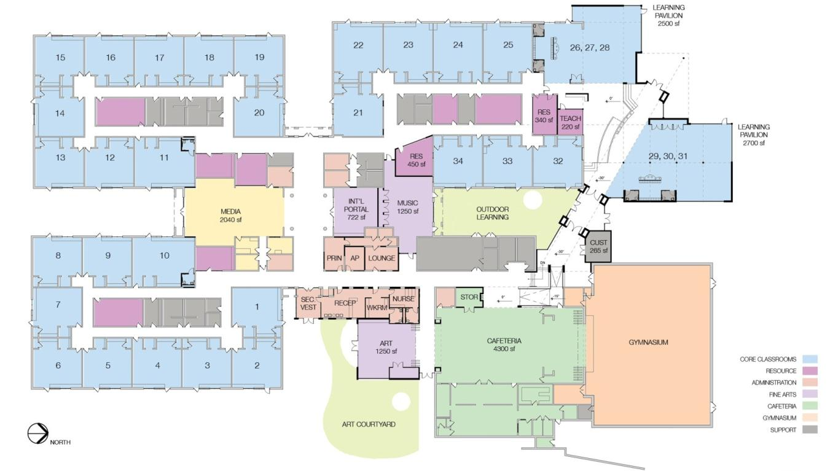
floor plan

Slide 12
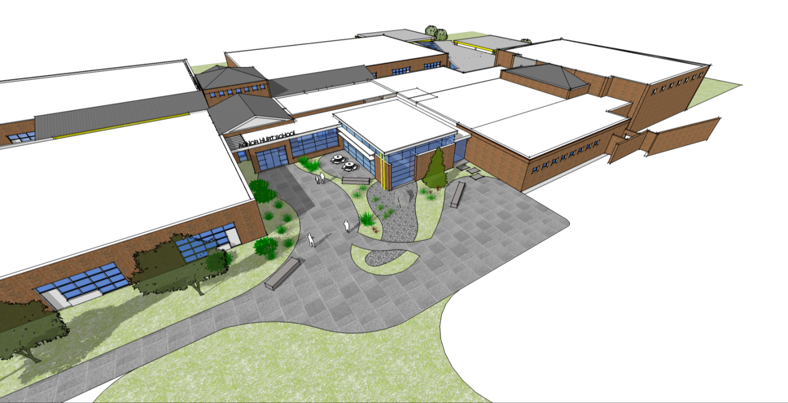
exterior view

Slide 13
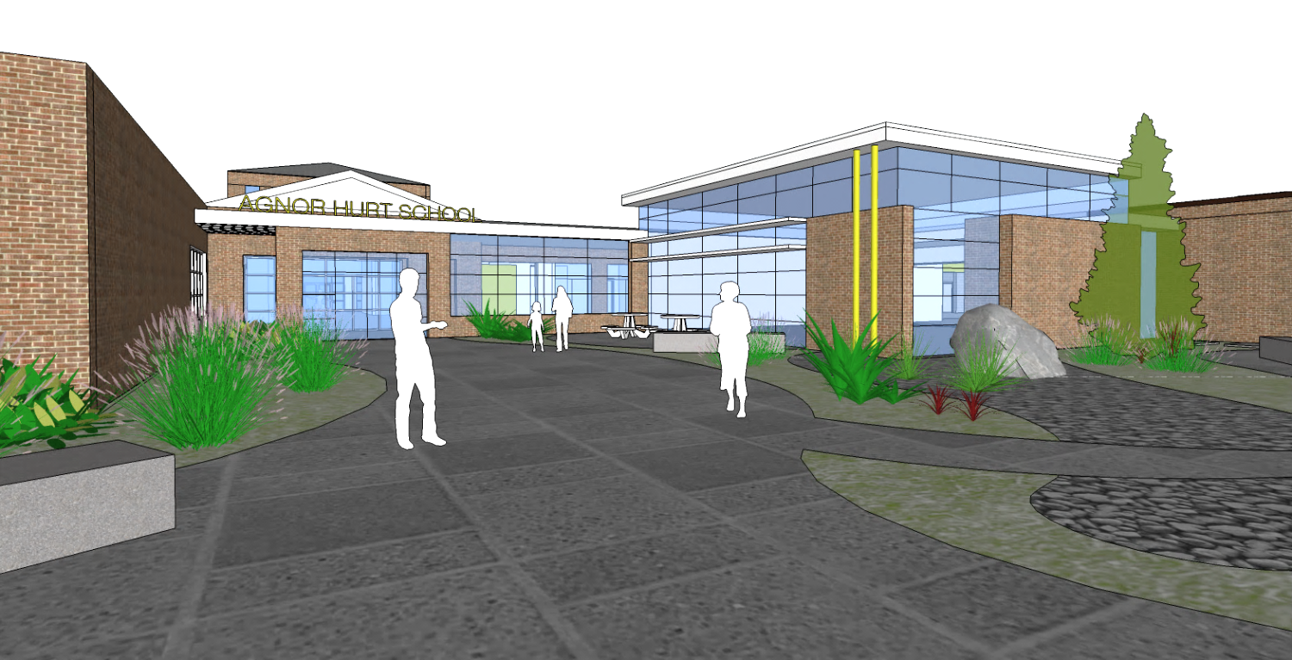
exterior view

Slide 14
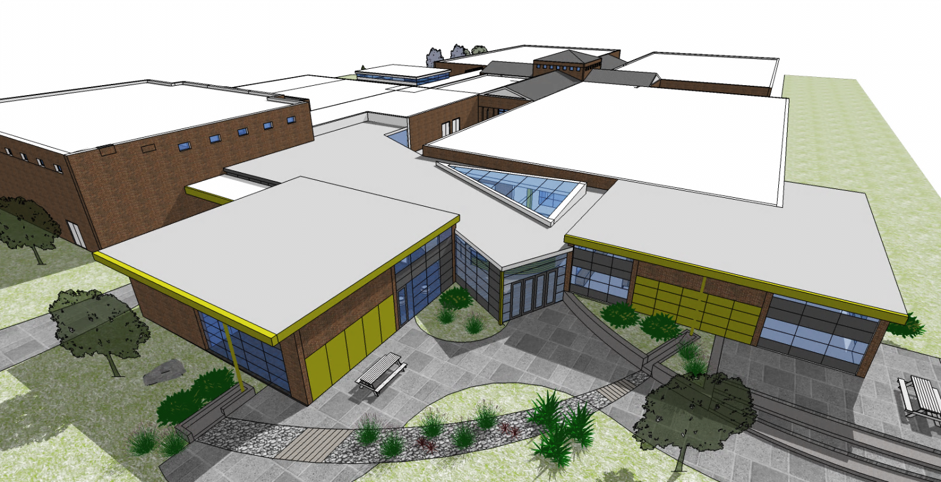
exterior view

